Slide 1
Digital Portfolio
STUDENT NAME: Vijaya lakshmi. S
REGISTER NO AND NMID: asumn1451222407534
DEPARTMENT: Bsc. Computer
COLLEGE: COLLEGE/ UNIVERSITY

Slide 2
PROJECT TITLE
Digital portfolio

Slide 3


AGENDA
Problem Statement
Project Overview
End Users
Tools and Technologies
Portfolio design and Layout
Features and Functionality
Results and Screenshots
Conclusion
Github Link
3/21/2024 Annual Review

Slide 4

PROBLEM STATEMENT
Lack of a centralized platform to showcase student skills and projects.
Difficulty in presenting portfolios during recruitment.
Existing solutions are either too generic or not customizable.

Slide 5
PROBLEM STATEMENT
Development of a digital portfolio system for students.
Provides an organized way to highlight skills, projects, achievements.
Accessible online for recruiters, mentors, and peers.

Slide 6

PROJECT OVERVIEW
Students – to showcase their work.
Recruiters/Companies – to evaluate student skills.
Faculty/Institutions – to track student progress.

Slide 7

WHO ARE THE END USERS?
Frontend: HTML, CSS, JavaScript, React.
Backend: Node.js / Django / Flask.
Database: MySQL / MongoDB.
Version Control: Git & GitHub.
Design: Figma / Canva.

Slide 8
TOOLS AND TECHNIQUES
Frontend: HTML, CSS, JavaScript, React. Backend: Node.js / Django / Flask. Database: MySQL / MongoDB. Version Control: Git & GitHub. Design: Figma / Canva.

Slide 9
POTFOLIO DESIGN AND LAYOUT
Simple, professional, and responsive UI.
Sections: About, Skills, Projects, Achievements, Contact.
Consistent color theme and typography.
Mobile-friendly design.

Slide 10
FEATURES AND FUNCTIONALITY
User login & profile creation.
Upload and manage projects with descriptions & links.
Add certifications, skills, and achievements.
Shareable portfolio link for recruiters.
Integration with GitHub / LinkedIn.

Slide 11
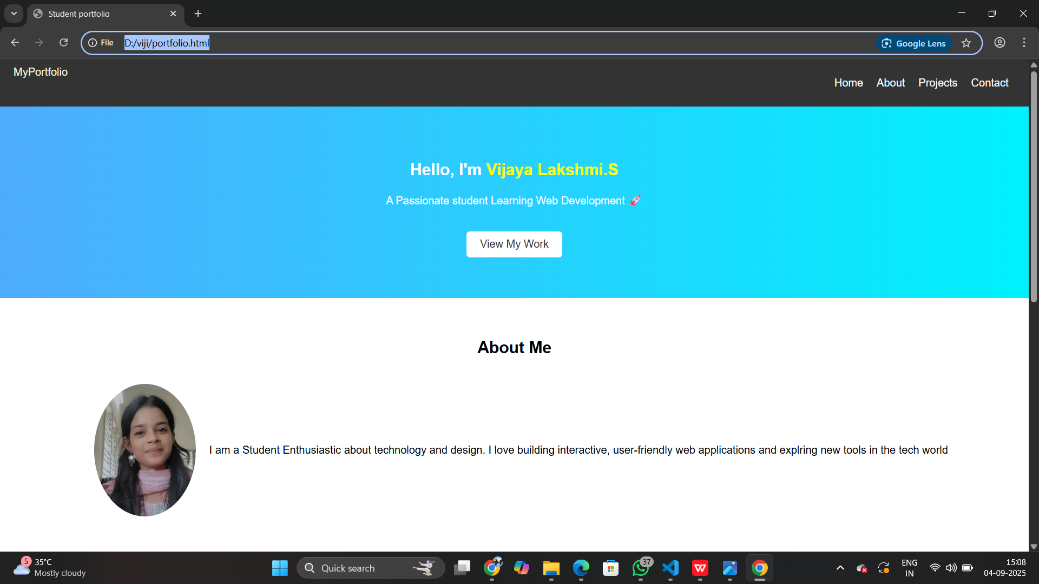
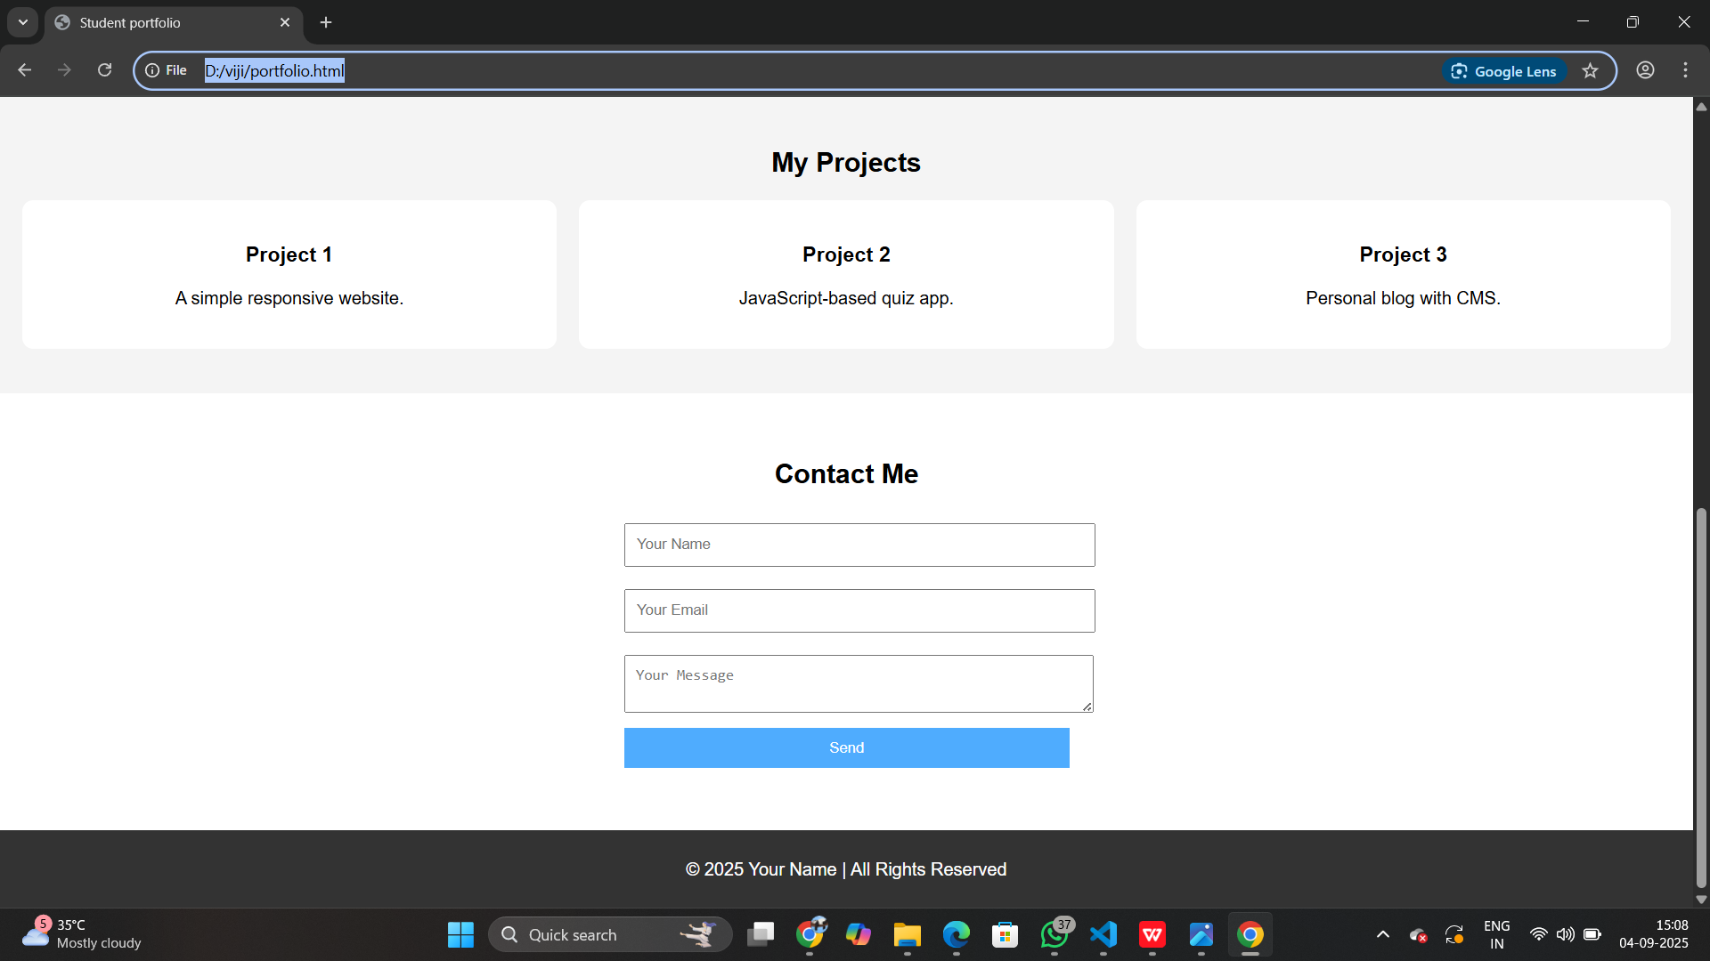
RESULTS AND SCREENSHOTS
3/21/2024 Annual Review

Slide 12
CONCLUSION
Provides students with a professional digital identity.
Increases visibility to recruiters.
Scalable for institutions to manage multiple students.
Future scope: AI-based skill recommendations, resume generator.

